Slide 1

UNIVERSITY COLLEGE OF ENGINEERING KANCHEEPURAM DEPARTMENT OF COMPUTER SCIENCE AND ENGINEERING
MAIN PROJECT
SECURE FILE STORAGE USING NEO-HYBRID CRYPTOGRAPHY
BATCH MEMBERS
1. Deepach Chandru M (513419104010)
2. Raghul J (513419104035)
3. Thillaivalavan A S (513419104049)
GUIDED BY – Mr. J. Devanathan M.Tech.,Teaching Fellow
‹#›
Notes:
‹#›

Slide 2
ABSTRACT
Security is a major concern in a wide range of applications, from cloud storage to messaging via chat. Many different approaches have also been proposed to provide data protection in the cloud, such as AES, DES, and RSA, but Existing systems often fail when only a certain form of encoding is utilized, either AES, OR DES, OR RSA depending on a consumer requirement. . Cryptographic techniques such as DES and AES are used in order to provide Security to the data but using a single technique sometimes doesn’t provide high-level security. So here the proposed work focused on introducing a hybrid cryptographic mechanism that involves multiple techniques to encrypt and decrypt the data.
‹#›
Notes:
‹#›

Slide 3
INTRODUCTION
The Internet is a public-interacted system; the amount of information exchanged over the internet is completely not safe. Protecting the information transmitted over the network is a difficult task and the data security issues become increasingly important. At present, various types of cryptographic algorithms provide high security to information on networks, but they also have some drawbacks. To improve the strength of these algorithms, a new hybrid cryptographic algorithm in is used.
‹#›
Notes:
‹#›

Slide 4
AIM / OBJECTIVE
The main objective of this project is to build a Hybrid Crypto-system that secures data on multiple layers and also ensures security of keys.
The Hybrid crypto-system also securely stores the keys so that they don’t lead to any vulnerabilities.
To create a crypto-system that provides excellent security without compromising on performance and speed.
To overcome the performance-security tradeoffs of cryptographic algorithms when used separately.
‹#›
Notes:
‹#›

Slide 5
EXISTING SYSTEM
Some system uses any one of the encryption algorithm.
Various combinations of Advanced Encryption Standard (AES), Elliptical Curve Cryptography (ECC) and Rivest, Shamir and Adleman (RSA) algorithms are used to provide hybrid encryption. Secure Hash Algorithm (SHA-256) is also used to provide authentication and integrity.
The most common hybrid system is based on the Diffie-Hellman key exchange, which is a method for exchanging private keys using public-key encryption.
‹#›

Slide 6
EXISTING SYSTEM- DRAWBACKS
Because only one encryption technique is used, and keys are not effectively supervised, there is a risk of key leakage.
AES, DES or RSA methods are used for encryption and the key sharing process is not secure.
Due to weak random number generator of RSA, it takes comparatively lesser time of cracking the algorithm.
‹#›
Notes:
‹#›

Slide 7
PROPOSED WORK
The proposed system, When a user uploads data, it is divided into five sections, the first of which is encrypted with AES, the second with BlowFish, the third with Triple-DES, the fourth part with IDEA and the fifth part with Fernet Algorithm.
LSB steganography is used to store the keys in the image, and the encrypted files are stored in the cloud.
Users must first recover the keys from the image before they can import all data from the server.
These keys are then used to decrypt the data once more with AES, Triple-DES, BlowFish, IDEA and Fernet
This approach increases the security of records.
‹#›

Slide 8
PROPOSED WORK-ADVANTAGES
Instead of DES, the system uses Triple-DES. Where it has three keys, the data is first encrypted with Key1 and then decrypted with Key2 and then encrypted back with Key3, which provides more security than DES.
Using BlowFish Algorithm rather than RSA, Blowfish is speedy enough to use on large documents, while RSA is pretty slow and therefore mostly used on small bits of data.
The largest Blowfish keys (448 bits) are significantly smaller than the smallest RSA keys (1024 bits)
The Keys and Encrypted files are then embedded in a cover image using LSB Steganography provides secure data transfer.
‹#›

Slide 9
LITERATURE REVIEW
S.No | Title | Author | Publication and Year | Context
1 | A Comprehensive Study of Digital Image Steganographic Techniques | SHAHID RAHMAN , JAMAL UDDIN, MUHAMMAD ZAKARYA, HAMEED HUSSAIN, AYAZ ALI KHAN, AFTAB AHMED, AND MUHAMMAD HALEEM | IEEE, 2023 | This paper deals about the Basic Concepts and Terminologies, Basic Structures of Steganography and Applications of Stagenography.
2 | Secure File Storage using Hybrid Cryptography | Putta Bharathi, Gayathri Annam, Jaya Bindu Kan di | IEEE, 2021 | Hybrid cryptography is used in this project, in which current encryption techniques are combined with three new methods.
3 | Hybrid Cryptography for Cloud Computing | Heena Kausar Khan, Rubika Pradhan, B. R. Chandavarkar | IEEE, 2021 | The proposed method RSA algorithm used for Authentication, blowfish algorithm ensures Data Confidentiality, and Secure Hash Algorithm-2 deals with Data Integrity
‹#›
Notes:
‹#›

Slide 10
LITERATURE REVIEW (CONT..)
S.No | Title | Author | Publication and Year | Context
4 | Hiding Data Using Efficient Combination of RSA Cryptography, and Compression Steganography Techniques | OSAMA FOUAD ABDEL WAHAB, ASHRAF A. M. KHALAF , AZIZA I. HUSSEIN , AND HESHAM F. A. HAMED | IEEE, 2021 | The proposed system deals about the efficient way of hiding data using combination of RSA Cryptography and Compression Steganography Techniques with its types(lossy and lossless)
5 | Improving Security with Efficinet Key Management in Public Cloud using Hybrid AES, ECC and LSB Steganography comparing with Novel Hybrid Cube Base Obfuscation | K Vandhana, Dr.S.Krishna Kumari | IEEE, 2022 | This proposed system compares the Hybrid AES, ECC and LSB steganography and cube based Obfuscation. Based on the experimental and statistical results achieved it is concluded that cube based obfuscation seems to be secure.
6 | Secure file storage on cloud using Hybrid cryptography | Vivek Sharma, Abhishek Chauhan, Harsh Saxena, Shubham Mishra, Sulabh BansAL | IEEE, 2021 | In this Proposes system, 3DES (Triple Data Encryption Standard) and Blowfish Algorithms are used to provide security.
‹#›
Notes:
‹#›

Slide 11
SYSTEM REQUIREMENTS
HARDWARE REQUIREMENTS
Processors: Intel’s Atom® processor or Intel’s Core™ processor i3 or above
Disk space: Recommended disk space is 1 GB
RAM: 2GB or more
SOFTWARE REQUIREMENTS
Operating systems: Microsoft Windows 7 or above, Apple’s macOS, & Linux
Python versions: Python 3.6.X and above
Libraries: pycrypto, stegano, random and other general purpose libraries
‹#›

Slide 12
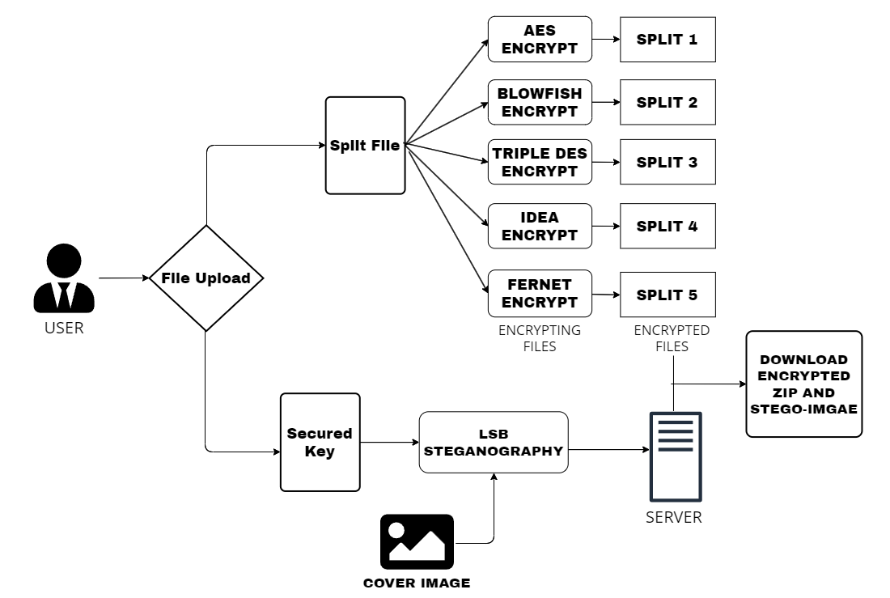
SYSTEM / ARCHITECTURE DIAGRAM ENCRYPTION

Slide 13
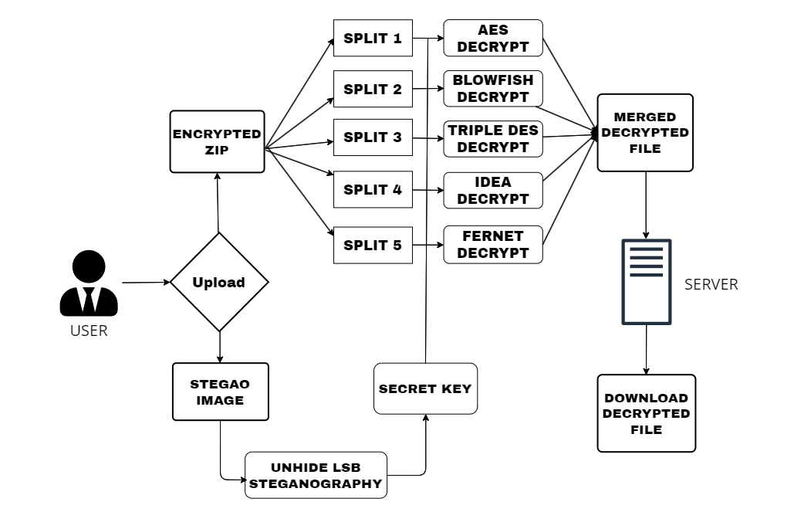
SYSTEM / ARCHITECTURE DIAGRAM DECRYPTION

Slide 14
SYSTEM MODULES
The system modules consists of
Data Pre-processing
Cryptography Algorithm
Steganography
Decryption and Extraction
‹#›

Slide 15
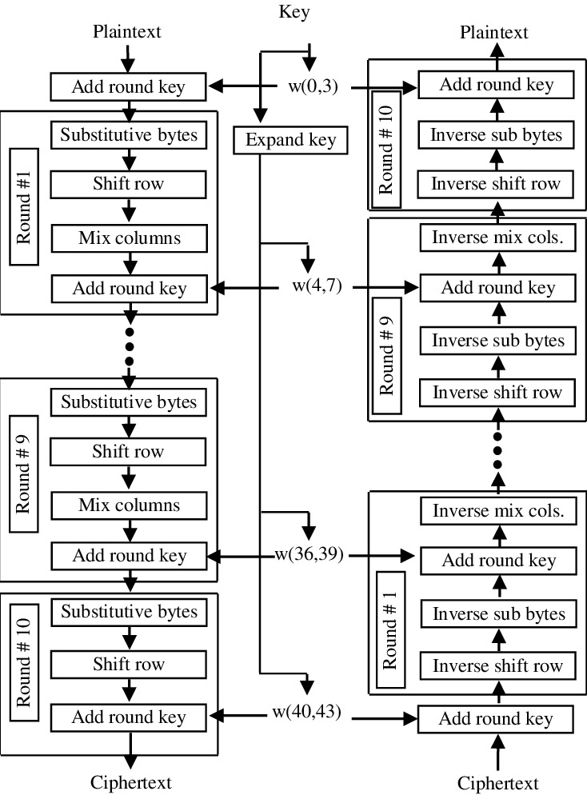
ALGORITHMS / TECHNIQUES USED
ADVANCED ENCRYPTION STANDARD(AES)
AES is one of the most extensively used and secure algorithms for data security.
It is a symmetric block cipher algorithm with a block/chunk size of 128 bits.
It converts these individual blocks using keys of 128, 192, and 256 bits.
Once it encrypts these blocks, it joins them together to form the ciphertext.

Slide 16
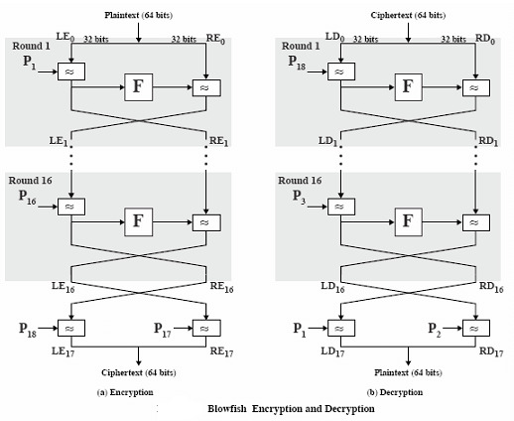
ALGORITHMS / TECHNIQUES USED
BLOWFISH ALGORITHM
Blowfish is a variable-length, symmetric, 64-bit block cipher.
It follows the Feistel network
It has a variable key size of 32-bits to 448-bits.
It is one of the first, secure block ciphers not subject to any patents and hence freely available for anyone to use.

Slide 17
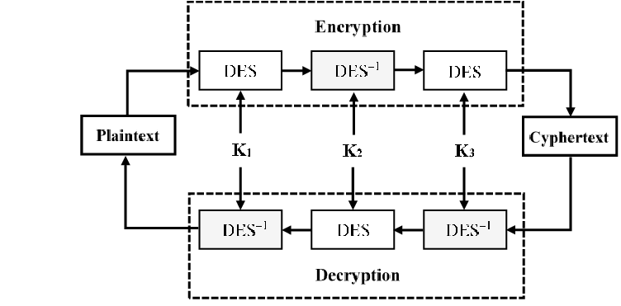
ALGORITHMS / TECHNIQUES USED
TRIPLE-DATA ENCRYPTION STANDARD(3-DES)
It is a symmetric-key block cipher
DES encryption works by taking a plaintext input and breaking it into smaller chunks (64-bit blocks) to encrypt it using a cryptographic key.
The algorithm takes the plain text in 64-bit blocks and converts them into ciphertext using 48-bit keys.

Slide 18
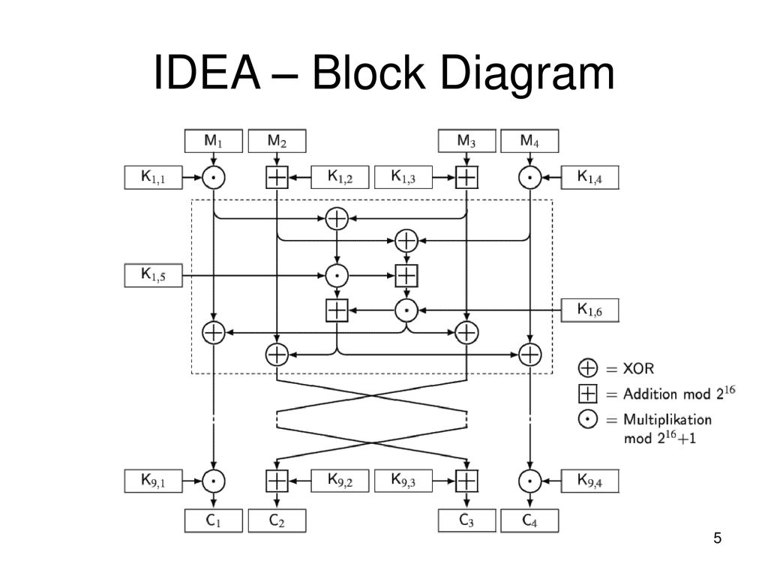
ALGORITHMS / TECHNIQUES USED
INTERNATIONAL DATA ENCRYPTION ALGORITHM (IDEA)
It is a symmetric key block cipher encryption algorithm designed to encrypt text to an unreadable format for transmission via the internet.
IDEA uses a 128-bit key and operates on 64-bit blocks.
Essentially, it encrypts a 64-bit block of plaintext into a 64-bit block of ciphertext.
This input plaintext block is divided into four sub-blocks of 16 bits each.

Slide 19
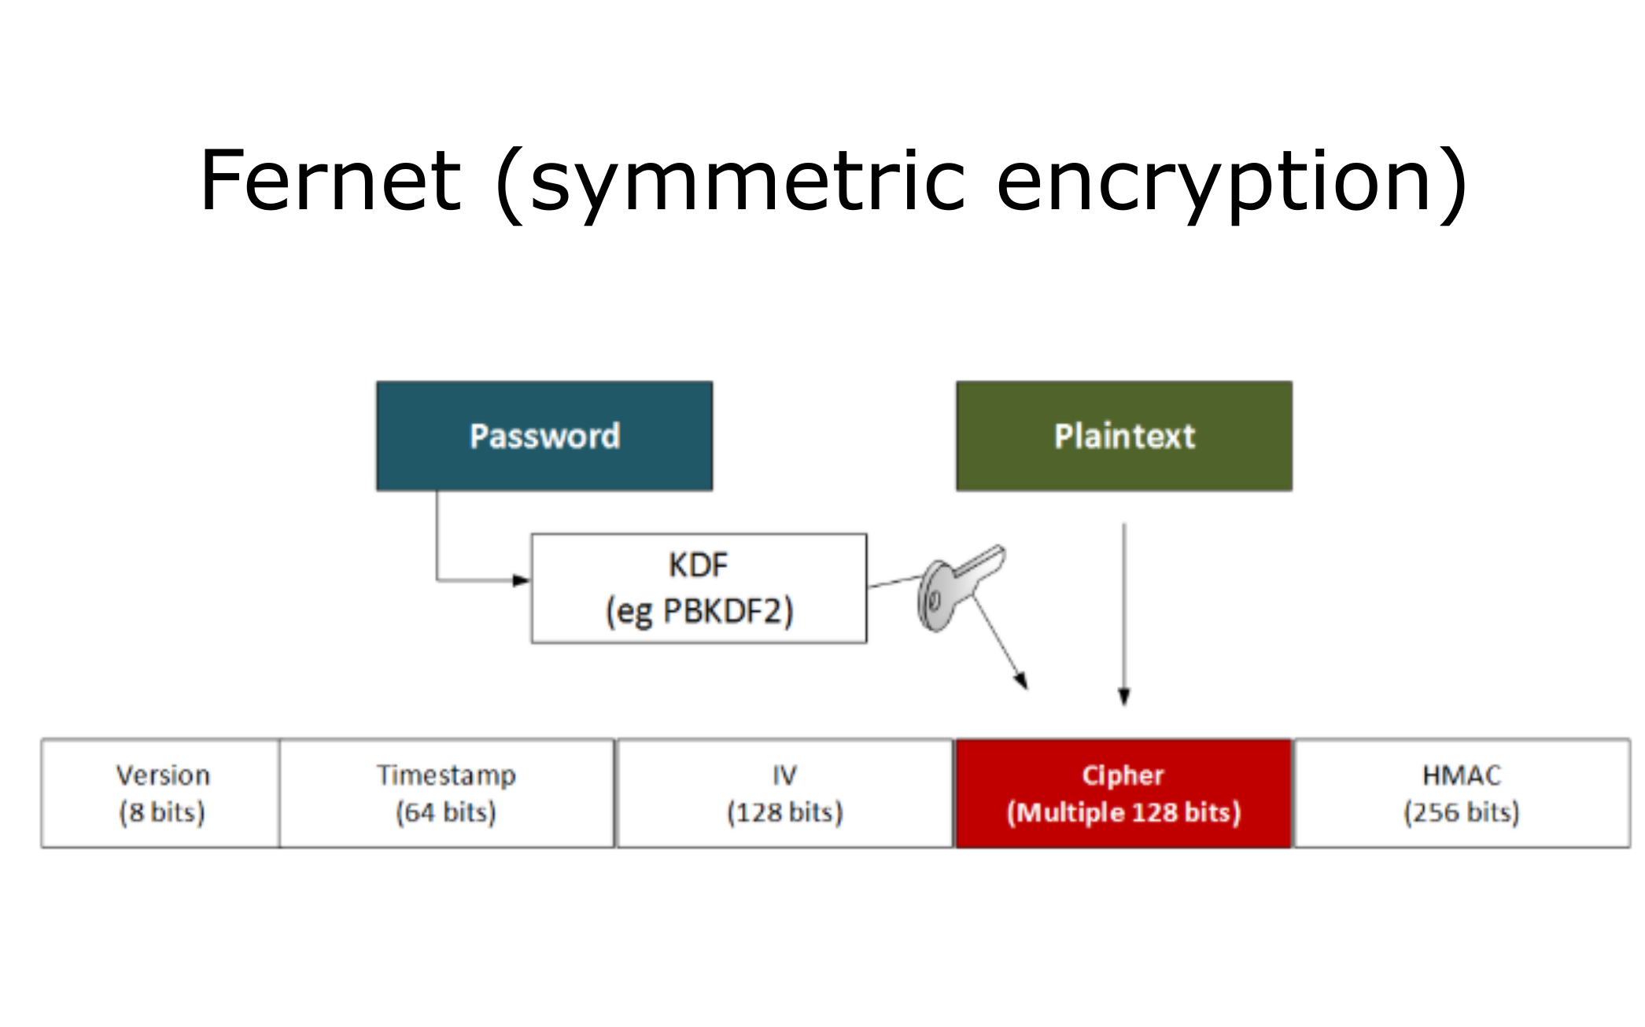
ALGORITHMS / TECHNIQUES USED
FERNET ALGORITHM
Fernet guarantees that a message encrypted using it cannot be manipulated or read without the key.
Fernet is an implementation of symmetric (also known as “secret key”) authenticated cryptography. Fernet also has support for implementing key rotation via Multi-Fernet .

Slide 20
CONCLUSION
The proposed cryptosystem uses a combination of symmetric cryptography to secure data.
The system also introduces a sub-process to encrypt the keys used for encryption before embedding them in an image.
The combination of Blowfish, AES, TripleDES has significantly improved the security and also ensured that the drawbacks of the standalone systems are addressed.
The system also helps in improving security without the use of keys of larger lengths
‹#›

Slide 21
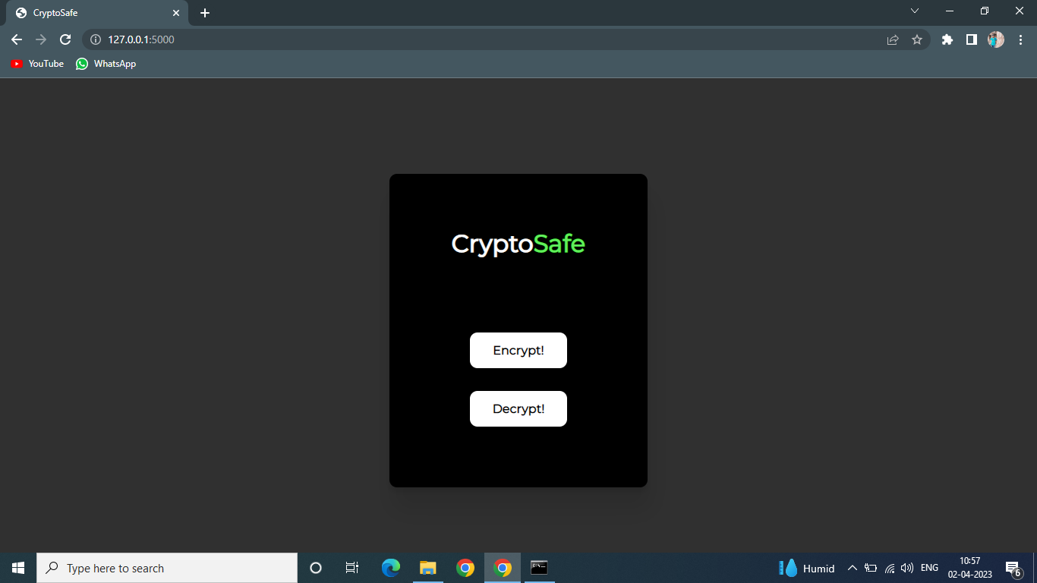
EXPECTED OUTCOME

Slide 22
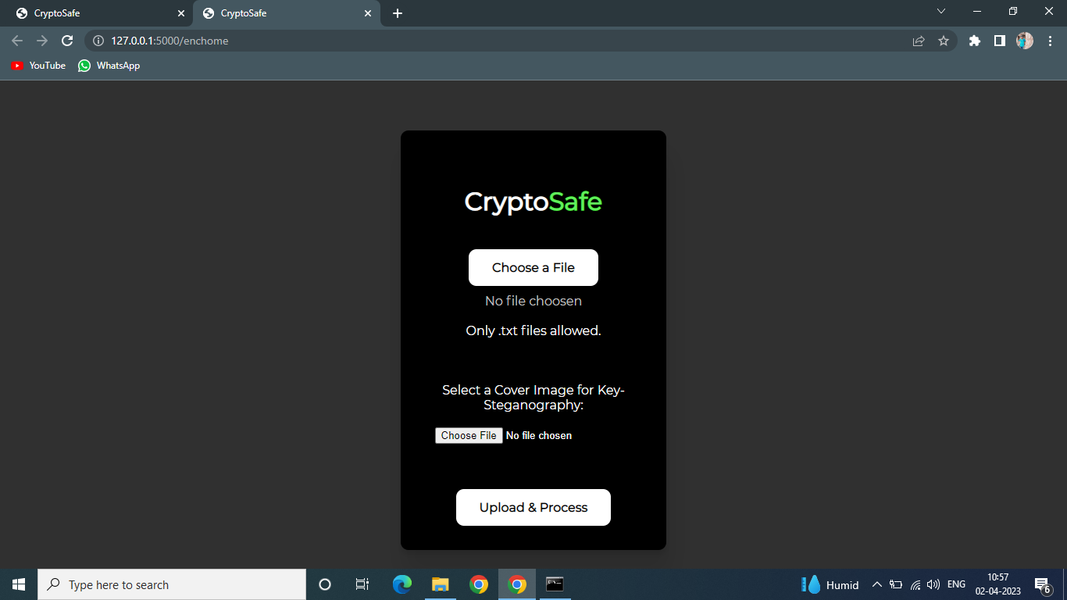
EXPECTED OUTCOME

Slide 23
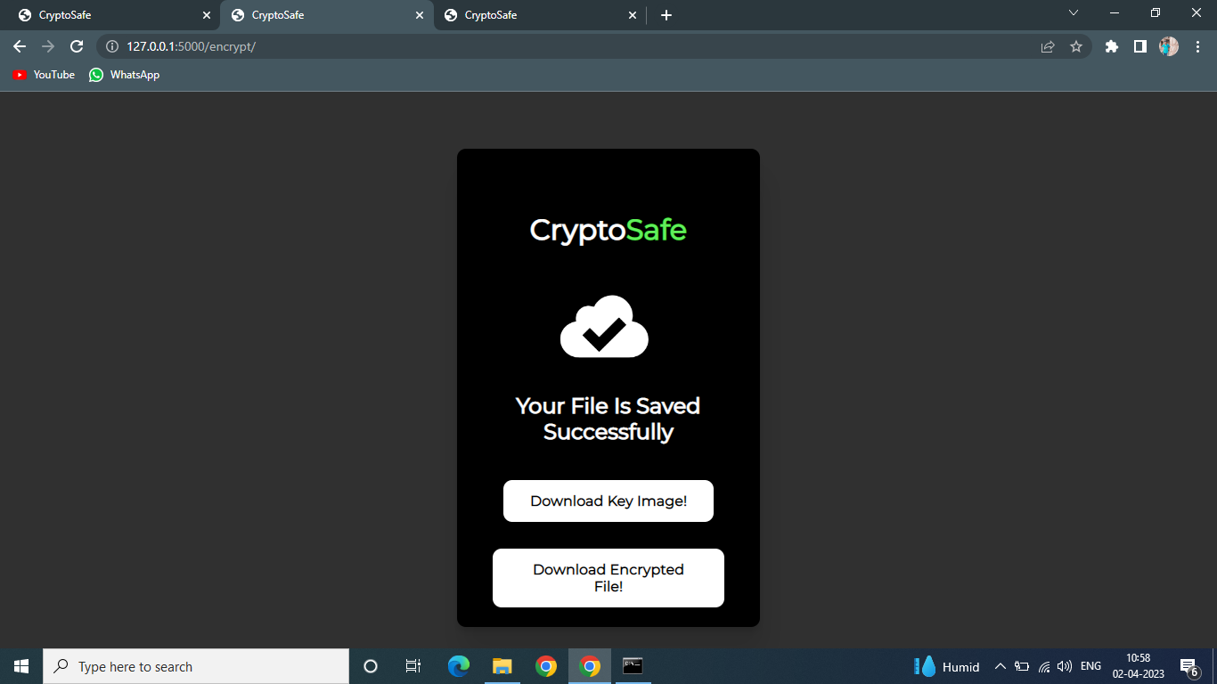
EXPECTED OUTCOME

Slide 24
REFERENCES
1. Secure File Storage Using Hybrid Cryptography: 2021 6th International Conference on Communication and Electronics Systems (ICCES) Authors: Putta Bharathi, Gayathri Annam, Jaya Bindu, Kandi Vamsi, Krishna Duggana and Anjali.T
2. An Efficient Algorithm for Confidentiality, Integrity and Authentication Using Hybrid Cryptography and Steganography 2019 : International Conference on Electrical, Computer and Communication Engineering ( ECCE), 7­9 February, 2019 Authors: Chitra Biswas, Udayan Das Gupta and Md. Mokammel Haque
3. Hybrid Implementation of Twofish, AES, ElGamal and RSA Cryptosystems: 2020 IEEE East­West Design &amp; Test Symposium (EWDTS) Authors: Elza Jintcharadze Maksim Iavich
4. Exploring LSB Steganography Possibilities in RGB Images: 2021 12th International Conference on Computing Communication and Networking Technologies Authors: Rutvik Dumre and Aashka Dave
5. Combined Cryptography and Steganography for Enhanced Security in Suboptimal Images: 2020 International Conference on Artificial Intelligence and Signal Processing (AISP) Authors:S. Joseph Gladwin and Pasumarthi Lakshmi Gowthami
6. Enhancing Data Security by using Hybrid Cryptographic Algorithm Authors, Publication & Year: Jigar Chauhan, Neekhil Dedhia, BhagyashriKulkarni ‐ IJESIT, 2013
7. Performance Comparison Between AES 256‐Blowfish and Blowfish‐AES 256 Combinations Authors:Publication & Year:Muhammad Abdul Muin, Muhammad Abdul Muin, Arief Setyanto, Sudarmawan, Kartika Imam Santoso ‐ ICITACEE,2018
‹#›

Slide 25
THANK YOU

